Slide 1
New features in QCM data acquisition GUI (v2.0a)

Slide 2
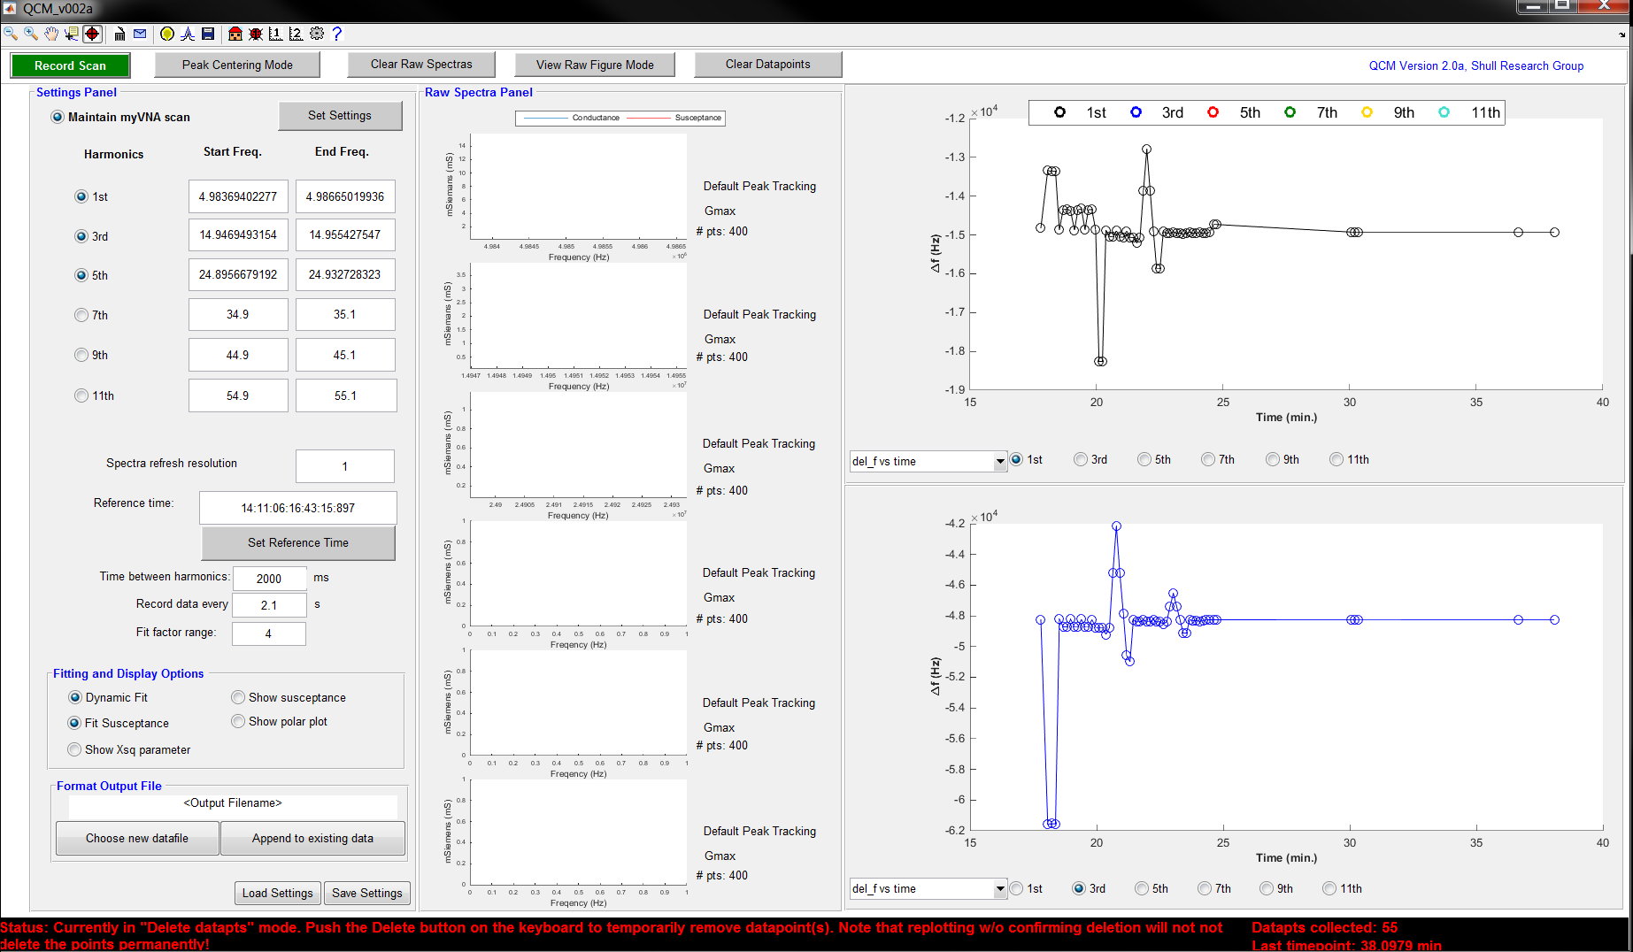
Overview of changes
3
6
9
2
5
8
11
1
4
7
10
12

Slide 3
Overview of changes
You can now delete spurious data points. Select a group of datapoints from the primary axes on the right and push the delete button on the keyboard. This function does the exact same thing as the “brush” tool. (Be sure to confirm the deletion by clicking on the icon!) For more details, look up the brush tool in the MATLAB help files.
Confirm deleting the points (see point 1)
Set up email notifications (beta)
Load bare crystal file. You need to load the frequency shift files <filename>.mat. This basically calculates the average frequency shifts for each harmonic and adjust the reference frequency values.
Refit raw spectras: you can not natively refit <filename>_raw_spectras.mat files in the program (beta). You can selectively choose which harmonic to fit. Go to peak centering mode to determine how you want to determine the initial guesses.
Save the frequency shift data
Reset GUI state (home button)
Debug
Adjust plot options for the primaryaxes1 handles (top right graph)
Adjust plot options for the primaryaxes2 handles (bottom right graph)
Set preferences (beta)
Help: loads the manual (beta and unfinshed/not updated)

Slide 4
Overview of changes
When the data points are cleared by clicking on the “Clear Datapoints” button, a backup of the collected dataset is stored in the folder “deleted data”. The location of the folder is the same as the current working directory MATLAB is in. The datasets are named based on the date in which the dataset was deleted
Email notifications now include a snapshot of the GUI
The “Preference” button ( ) is not finished. However, the available options are working properly.
You can now append measurements to a previous set of dataset by simply choosing which file to append the data. Click on the “Append to existing data” button to do this.
A window will pop up and prompt to choose which file to append the frequency shifts to

Slide 5
Other misc. changes
The plotting system has changed dramatically. The program no longer relies on the MATLAB (plot functions). Instead, the program modifies the xdata and ydata property of the plot handles. Also, plot handles are no longer deleted/created after each iteration. Instead, plot handles are created before any for/while loops or when the “Clear Raw Spectras” or “Clear Datapoints” are clicked. During each iteration in a while/for loop, the plots handles are set to invisible or visible. This change prevents the GUI from stealing focus (aka you can do other things on the computer while the measurement is taking place). Also, this helps reduce memory consumption and allows the program to run more smoothly.
The number of datapoints that are preallocated for storing frequency shift data has been set to 25,000 points. In other words, a maximum of 25,000 data points can be collected. If necessary, this value can be changed ~ line 80. The maximum number of points is stored in the variable, handles.din.max_datapts.

Slide 6
Other misc. changes
The command window is now color-coded for easier viewing of the log of actions during the measurement process
If the AccessMyVNA program is running and taking active measurements, MATLAB will close the AccessMyVNA program when the GUI is closed.
The number of datapoints collected and the last timepoint in which a measurement was made is now shown in the status bar
Error messages generated by MATLAB during the measurement process will by exported to the “base” workspace.
The GUI program version will be saved in the data (.mat) files (<filename>_settings.mat, <filename>.mat, <filename>_settings.mat)

Slide 7
Known issues
When you are in “Peak Centering Mode” and you are fitting the dataset, closing out of the figure that has the raw spectra plots before the figure with the polar plot of the spectra data appears will cause MATLAB to crash
The View Raw Figure Mode is still buggy when you turn this on during data collection. Use the function during data collection at your own risk!
Note: this functionality still works fine outside of data collection (when “record scan” is not running). The intention of this function is to provide an easy way to inspect the raw harmonics. Also, this function allows for easy export of the raw spectra.
If you are running MATLAB 2014b or higher and your graphics driver is not updated, MATLAB will crash when it plots. If this happens, type in this command: opengl('save','software') in the command window. You only need to do this once.
The refitting procedure is not capable of refitting multiple peaks

Slide 8
Known issues
If you are running AccessMyVNA in Windows 8 or higher, the program will not run (it simply crashes and closes itself). To fix this, right click on AccessMyVNAv0.7/release/AccessMyVNA.exe and click on “properties”. Go to the tab that is labeled “Compatability” and click on “Run this program in compatability mode for:”. In the drop-down menu, choose “Windows 7”.
If you are using MATLAB 2014b or higher, the program may feel sluggish compared to running the program on MATLAB 2014a or lower. Simply open the “QCM.v002a.fig” in GUIDE and double click on the white-gridded background. This will open up the options associated with the GUI figure. (be sure to not double click on the panels!) Change the “Renderer” option to “opengl”

Slide 9
Known issues
If you are using MATLAB 2014a or lower, you might notice that the command window will be spammed with repeated lines of:
Current plot held
Current plot held
Current plot released
Current plot released
This is due to how the function “hold” was coded in MATLAB. This “spamming” will only occurs whenever the plot handles are recreated (before data collection and after datacollection).
If you use MATLAB 2014b, the function “hold” has been modified so that it will no longer spam the command window.

Slide 10
Known issues
The Xsq parameter is not strictly a “Chi-squared” parameter. It is currently calculated as the least-squares value of the Lorentzian fit.
You can safely ignore the warning message that pop up when the GUI initialized. The warning message is just saying that the qcm_diary.txt is not found. The program will recreate/delete the text file when necessary.

Slide 11
Feedback and contact
If you have suggestions or run into issues, feel free to email me at CHJoshuaYeh@u.northwestern.edu!

